Slide 1
M&C Program Reporting Process
July 2013

Slide 2
Purpose
Scope
    This process defines the Framework for managing Program Reporting
Objectives
    Ensure understanding of Program reporting inputs/outputs
    Ability to summarise progress to plan
    Highlight key RAID items for Management attention
    Ensure Execs and Sponsors gain a snapshot of Program status
    Enable the business to make informed decisions
    Allow metrics to be provided which highlight common challenges
    Demonstrate that the Project/Program is being controlled
    Ensure quality and consistent reporting across all Workstreams
July 2013

Slide 3
Report Types
Program ITS Status Report
    Fortnightly report (or as per ITS Reporting calendar)
    ITS level status reporting requirement
    The report will be uploaded into the IT PM Tool by the M&C PMO Team
    Program ITS Status Report Template (add link)
Sub-Program Health Report
    Weekly Report
    It forms the basis of the agenda for the Weekly Program Management meeting
    It provides a RAG snapshot of the status of each individual program summary of the program delivery lifecycle stages.
    Sub-Program Health Report (add link)
Executive Report
    Monthly Report
    Produced for Program Sponsors and Executives
    There is currently confirmed schedule for this report
    M&C PMO will contact Workstream Leads for inputs as required

Slide 4
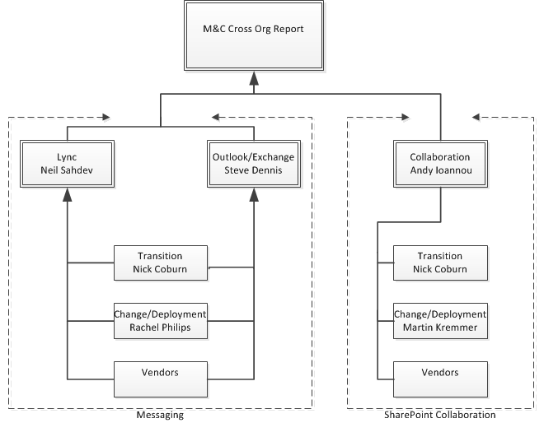
Workstreams?
    The following Program Workstreams are currently required to submit reports:
      Messaging Lync
      Messaging Outlook/Exchange
      Collaboration Release 1
      Collaboration Release 2
    The reports should also represent dependant workstream statuses in all their reports e.g. Transition, Change and Deployment.
Fortnightly Program ITS Status Report
Weekly Program
Sub-report

Slide 5
  Workstream Lead Responsibilities
Day | Monday | Tuesday | Wednesday | Thursday | Friday
Reports | Review Program ITS Status Report feedback (Fortnightly) | PMs submit Sub Program Health Reports to Workstream Leads. (Weekly) | Review and consolidate Program Health Reports (Weekly) | Submit Sub-Program Health Report (Weekly, 3pm) Submit Program ITS Report (Fortnightly 3pm) | Complete Exec level report pack. (Ad-Hoc only as requested)
Meetings | Workstream Status Meetings | Attend Program Management Meeting (Weekly, 1pm) |  |  | PMO QA Review - Involves a different PM for every session (Fortnightly 10am)
  Workstream Leads must upload completed reports into SharePoint folder created by PMO
    M&C PMO will email the link to the latest folder repository to the Workstream Leads on a weekly basis
  Workstream Leads should use the following naming convention below when uploading the reports:
  <<Program>> <<Workstream>> <<Period of Reporting>><<Status Report>><<MMMYYYY>>
  Collaboration Release 1 (Mid-Month or Month End) Status Report Jul 2013
July 2013

Slide 6
Useful links
Program ITS Status Report Template
Sub-Program Health Report Template
Executive Report Template
Program RAG Reporting Guidelines
Program Reporting Cadence
July 2013

Slide 7
Thank you

